Slide 1
Exp-03 : Demonstrate the operation of unbiased and biased positive and negative clipper circuits
EEE 2114
PRESENTED BY – (GROUP I)
NAIMUR RAHMAN
DEPARTMENT OF COMPUTER SCIENCE AND ENGINEERING
KHULNA UNIVERSITY OF ENGINEERING & TECHNOLOGY (KUET)
ROLL – 1907031
YEAR – 2ND
SEMESTER – 1ST
MD. RABBY ISLAM
DEPARTMENT OF COMPUTER SCIENCE AND ENGINEERING
KHULNA UNIVERSITY OF ENGINEERING & TECHNOLOGY (KUET)
ROLL – 1907061
YEAR – 2ND
SEMESTER – 1ST

Slide 2
OBJECTIVES:
To understand the internal building structure of a clipper circuit.
To understand wave shaping circuits practically.
To understand the switching property of a diode.
THEORY :
Clipper circuits are the electronic circuits that clip off or remove a portion of a AC signal without causing any distortion to the remaining part of the signal.
Based on the level of clipping there are two types of clipper circuits :
Positive Clippers
Negative Clippers
Based on biasing there are also two types of clipper circuits:
Unbiased Clippers
Biased Clippers
So, both types can create 4 different combinations of clipper circuits.

Slide 3
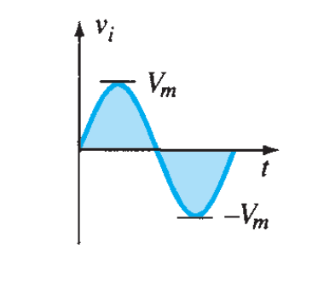
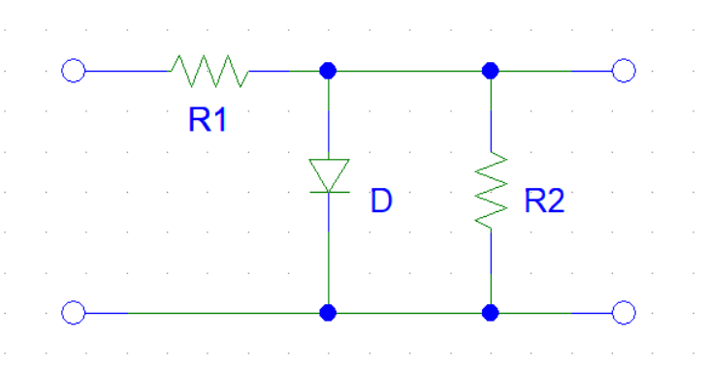
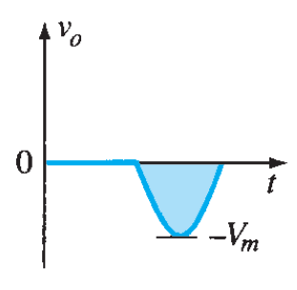
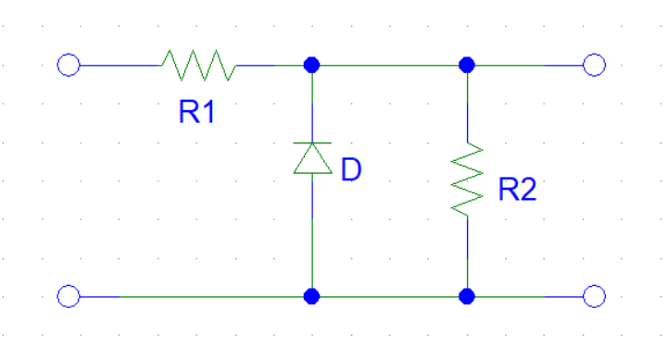
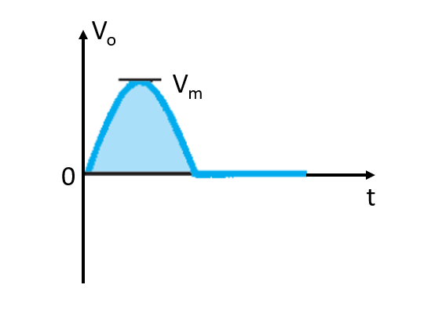
UNBIASED POSITIVE CLIPPER :
Input
Unbiased Positive Clipper Circuit
Output
Case – I : Vin > 0 (Ideal diode), D is forward biased. So, Vo = 0 V
Case – II : Vin < 0 (Ideal diode), D is reverse biased. So, Vo = Vin
UNBIASED NEGATIVE CLIPPER :
Input
Unbiased Negative Clipper Circuit
Output
Case – I : Vin > 0 (Ideal diode), D is reverse biased. So, Vo = Vin
Case – II : Vin < 0 (Ideal diode), D is forward biased. So, Vo = 0 V

Slide 4
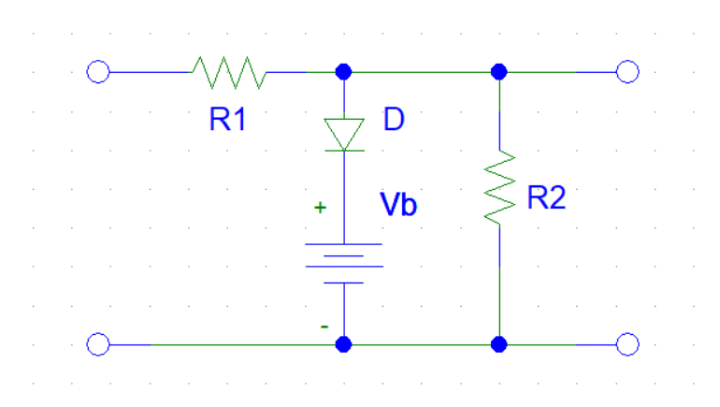
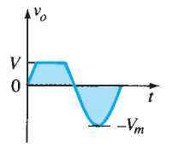
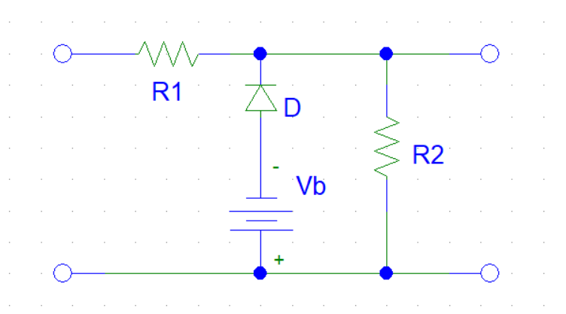
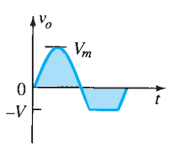
BIASED POSITIVE CLIPPER :
Input
Biased Positive Clipper Circuit
Output
Case – I : Vin > V_{b} (Ideal diode), D is forward biased. So, Vo = V_{b}
Case – II : Vin < V_{b} (Ideal diode), D is reverse biased. So, Vo = Vin
BIASED NEGATIVE CLIPPER :
Input
Biased Negative Clipper Circuit
Output
Case – I : Vin > V_{b} (Ideal diode), D is reverse biased. So, Vo = Vin
Case – II : Vin < V_{b} (Ideal diode), D is forward biased. So, Vo = -V_{b}

Slide 5
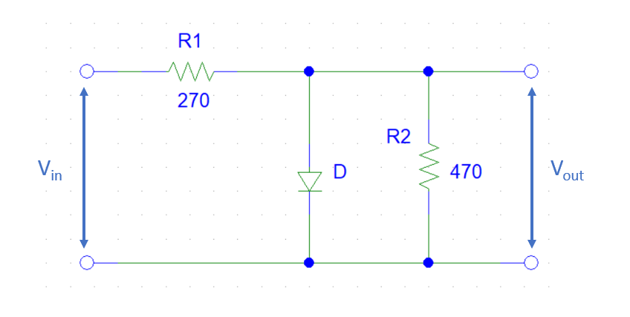
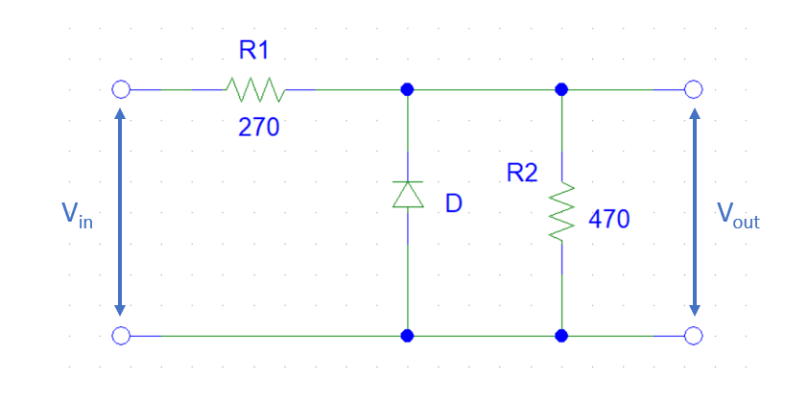
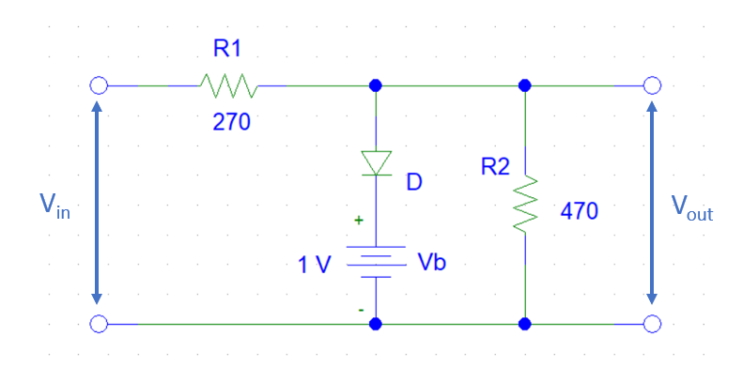
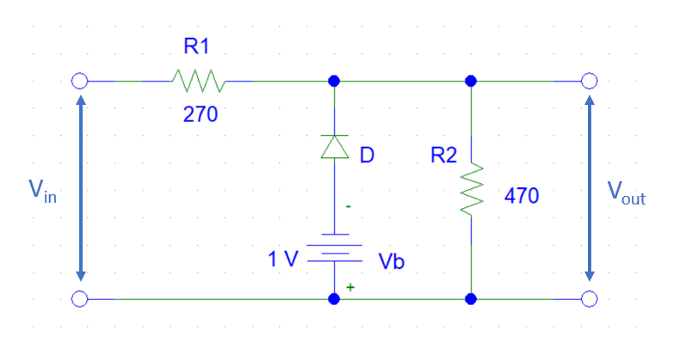
EXPERIMENTAL SETUP :
Setup-1: Unbiased Positive Clipper
Setup-2: Unbiased Negative Clipper
Setup-3: Biased Positive Clipper
Setup-4: Biased Negative Clipper

Slide 6
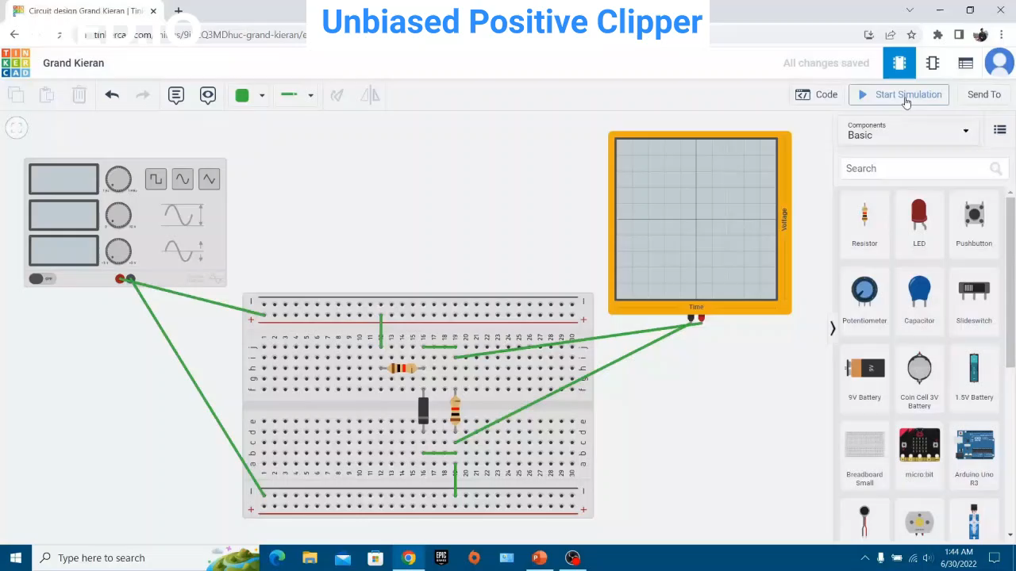
SIMMULATION : (USING TINKERCAD)

Slide 7
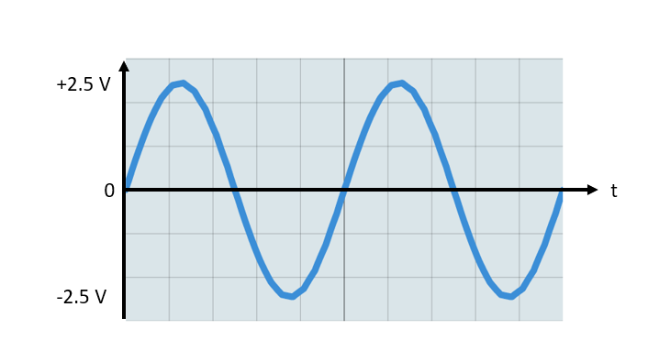
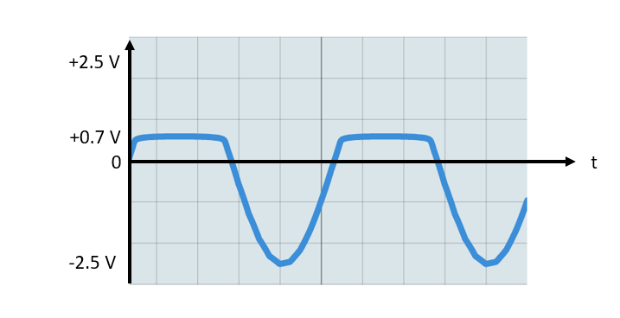
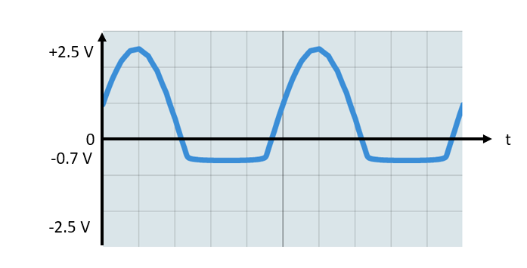
INPUT/OUTPUT :
INPUT
OUTPUT
UNBIASED
POSITIVE
CLIPPER
UNBIASED
NEGATIVE
CLIPPER

Slide 8
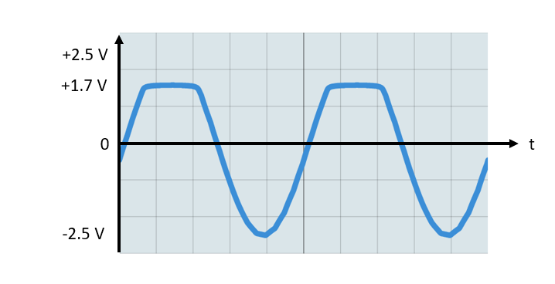
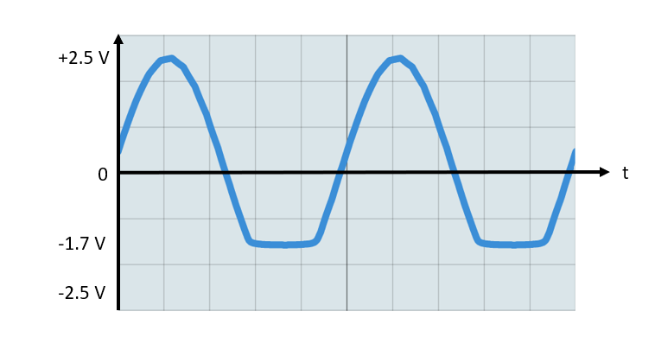
INPUT/OUTPUT :
INPUT
OUTPUT
BIASED
POSITIVE
CLIPPER
BIASING
VOLTAGE
= 1 V
BIASED
NEGATIVE
CLIPPER

Slide 9
CONCLUSION :
In this experiment, the switching property of diode played the pivotal role :
During forward bias, diode acts as a short circuit and no voltage is found across the parallel resistor and so Vo = 0 V or V_{D}
During reverse bias, diode acts as an open circuit and the entire input voltage is found across the parallel resistor and so Vo = Vin
In biasing case, during the forward bias condition, the biasing voltage is added to the output found across the resistor and so Vo = V_{B} or V_{D} + V_{B}
The biasing voltage taken should maintain the condition, V_{B} < Vin - V_{D} unless there won’t be any clipping of the input signal

Slide 10
APPLICATIONS:
The clipper circuit offer overvoltage protection therefore, it is used in power supplies for limiting the voltage.
They are used for filtering noise in transmitters.
For the generation of new waveforms or shaping the existing waveform, clippers are used.
Clippers can be used as voltage limiters and amplitude selectors.
Clipper circuits are widely used in signal receiving and signal transmitting devices, communication systems.
THANK YOU

